Slide 1
LINQ Connect Social Media Kit
2024

Slide 2
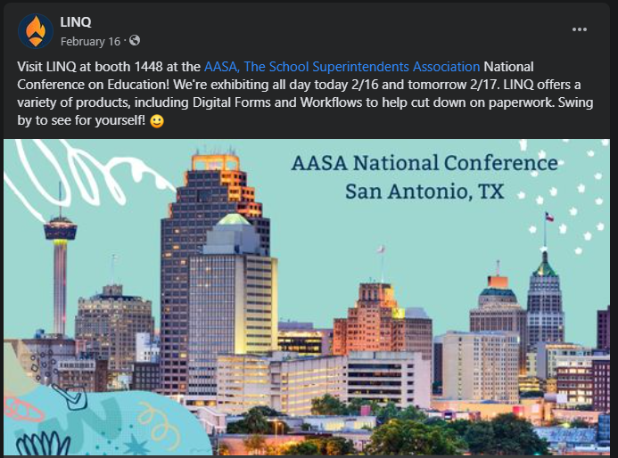
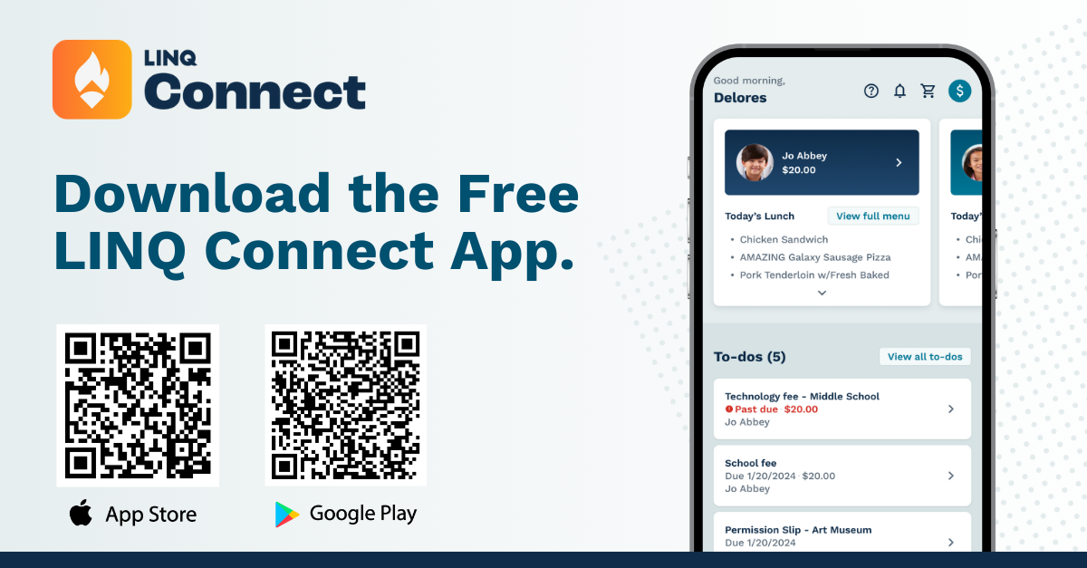
Social Media Script #1
LINQ Connect App Launch Social Media Kit
We’re thrilled to announce LINQ Connect - our new platform to simplify school-related payments like lunches, field trips, activities, yearbooks, and fees. 🌟 Download the app from your app store or visit LINQ Connect to register. Look out for an enhanced app coming Summer 2024! Join us in making school payments easier with LINQ Connect! 🙌 #LINQConnect #SchoolPayments
Copy: We’re thrilled to announce LINQ Connect - our new platform to simplify school-related payments like lunches, field trips, activities, yearbooks, and fees. 🌟 Download the app from your app store or visit LINQ Connect to register. Look out for an enhanced app coming Summer 2024! Join us in making school payments easier with LINQ Connect! 🙌 #LINQConnect #SchoolPayments
2

Slide 3
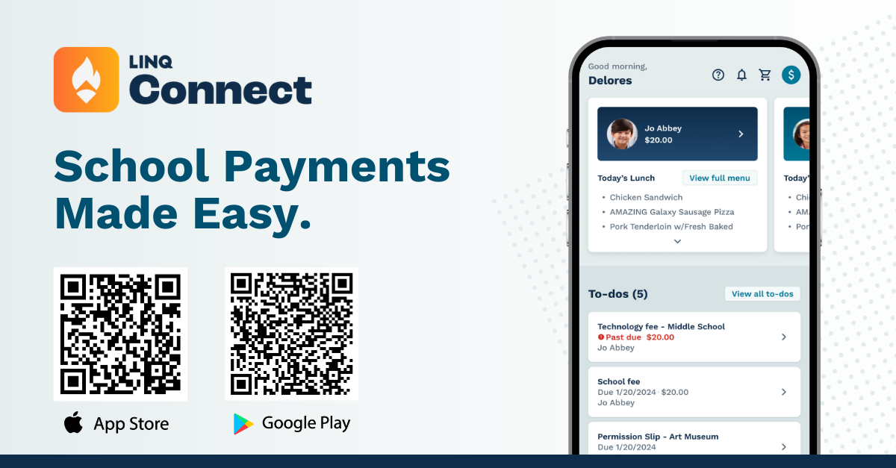
Social Media Script #2
LINQ Connect App Launch Social Media Kit
We’re thrilled to announce that LINQ Connect will be launching a new and improved mobile app in Summer 2024! Get ready for a fresh look and enhanced features to make managing school payments even easier. 📲✨What’s New? 🔹 User-Friendly Interface: Streamlined design for easier navigation. 🔹 Improved Functionality: Simplified payments for lunches, field trips, activities, and more. 🔹 Real-Time Updates: Instant notifications about account balances and payments. 🔹 Secure Transactions: Advanced security to protect your information. Stay tuned for the launch and experience the new LINQ Connect! 🙌 #LINQConnect #SchoolPayments #ComingSoon
Copy: We’re thrilled to announce that LINQ Connect will be launching a new and improved mobile app in Summer 2024! Get ready for a fresh look and enhanced features to make managing school payments even easier. 📲✨What’s New? 🔹 User-Friendly Interface: Streamlined design for easier navigation. 🔹 Improved Functionality: Simplified payments for lunches, field trips, activities, and more. 🔹 Real-Time Updates: Instant notifications about account balances and payments. 🔹 Secure Transactions: Advanced security to protect your information. Stay tuned for the launch and experience the new LINQ Connect! 🙌 #LINQConnect #SchoolPayments #ComingSoon
3

Slide 4
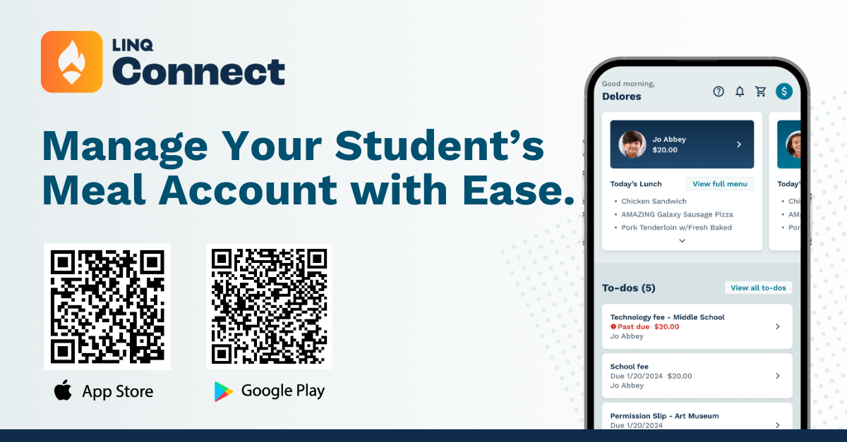
Social Media Script #3
LINQ Connect App Launch Social Media Kit
We’re thrilled to announce that LINQ Connect has upgraded their mobile app! 🎉 Easily download or update the app from the Google Play Store or Apple Store with just a few clicks. If you already have the app, look out for an automatic update in August! 📲✨
🌟 Set up one-time or recurring payments for student meals 🌟 View recent purchases 🌟 Set spending limits 🌟 Transfer funds between students 🌟 Set low-balance notifications 🌟 And more!
Manage student activity fees and meal payments hassle-free with LINQ Connect. 🙌 #LINQConnect #SchoolPayments
Copy: We’re thrilled to announce that LINQ Connect has upgraded their mobile app! 🎉 Easily download or update the app from the Google Play Store or Apple Store with just a few clicks. If you already have the app, look out for an automatic update in August! 📲✨
🌟 Set up one-time or recurring payments for student meals 🌟 View recent purchases 🌟 Set spending limits 🌟 Transfer funds between students 🌟 Set low-balance notifications 🌟 And more!
Manage student activity fees and meal payments hassle-free with LINQ Connect. 🙌 #LINQConnect #SchoolPayments
4

